Slide 1

sdhshdssdhshdhsd
https://www.bhojdeals.com
Selenium Automation Framework: Python & POM

Slide 2
Problem Statement
Before automation, the Bhoj Deals website faced significant testing hurdles:
Slow & Repetitive
Error-Prone Processes
Manual execution of test cases consumed excessive time and resources, hindering release velocity.
Human error in repetitive tasks led to missed defects and inconsistent test coverage.
Missing Key Coverage
UI Volatility
Core workflows like login, search, and checkout lacked comprehensive automation, leaving critical paths vulnerable.
Frequent UI changes made, often breaking existing test cases.

Slide 3




Objectives:
I aimed to build a comprehensive, resilient framework to address above challenges:
Automate Workflows
Ensure end-to-end automation of critical customer journeys across the Bhoj Deals platform.
Performance & Security
Integrate stress tests for search performance and implement security tests for vulnerabilities like SQL injection.
Modular Design (POM)
Utilize the Page Object Model (POM) for enhanced modularity, maintainability, and code reusability.
Reporting
Generate detailed HTML reports for quick defect identification and analysis.

Slide 4


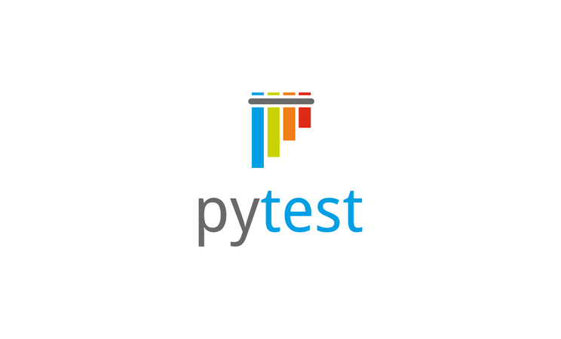
Tools and Technologies
Python 3.13.9
The primary programming language for its simplicity and extensive libraries.
Selenium Web Driver
For browser automation and interaction with web elements.
Pytest
Our chosen testing framework, providing powerful fixtures
and assertion capabilities.

Slide 5
Logging module
Critical for debugging and tracking test execution flow.
X path / CSS selectors
Robust locator strategies for identifying web elements accurately.
Pytest-HTML
For generating comprehensive and visually appealing test reports.
PyCharm
Integrated Development Environment (IDE) specifically designed for Python programming.

Slide 6
Implementation:
Phase 1 — Requirement Understanding
Identified core test cases: Login/Logout, Get Location, Search, Filter, View Menu, Checkout.
Phase 2 — Test Strategy & Planning
Selenium + Python + Pytest with Page Object Model (POM).
Added pytest-html reports, logging, and scalable folder structure.
Phase 3 — Framework Design
Structure: test_cases/, page_obj/, setup/, reports/.
Implemented BaseTest (setup/teardown).
Phase 4 — Development
Created page modules for all features.
Phase 5 — Execution & Validation
Ran all test cases, captured HTML reports and execution time.

Slide 7
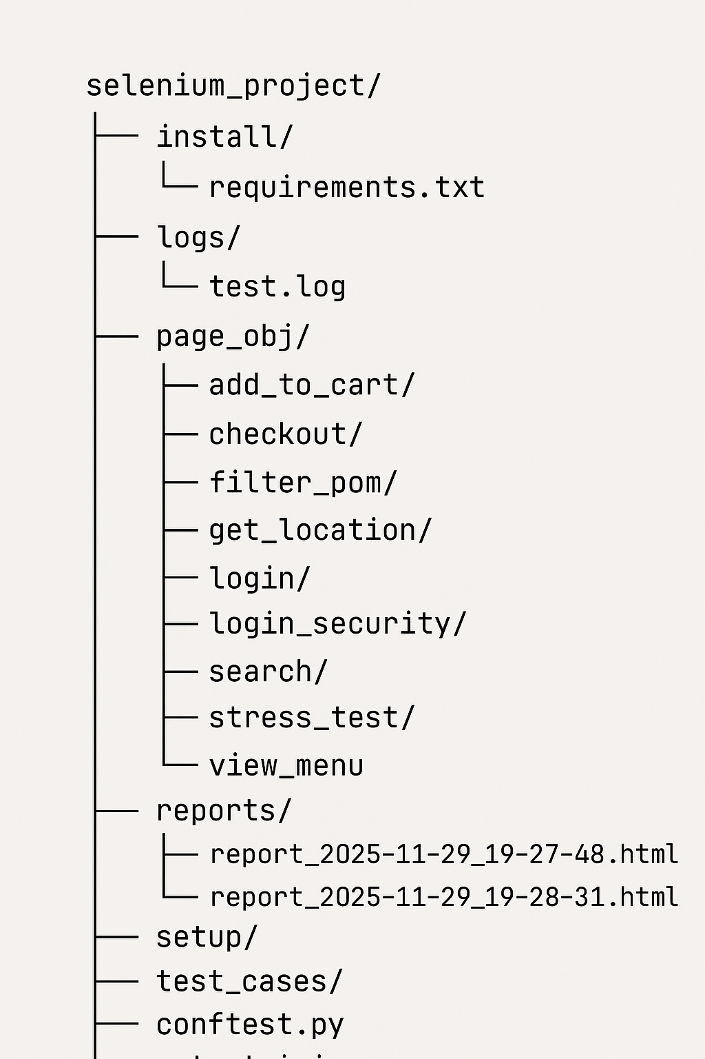

Architecture: Design and Development
Folder
Structure
Key Design Principles​
Page Object Model (POM): Ensures high modularity by separating UI elements and actions from test scripts.
​ WebDriver Management: base_test.py centrally manages WebDriver setup and teardown for consistency.​
Reporting Integration: conftest.py is used for configuring HTML reports.​
Feature Isolation: Each module specifically handles one feature, promoting clean separation of concerns.
Readable Tests: Test scripts remain concise, calling only high-level actions defined in the POM.

Slide 8
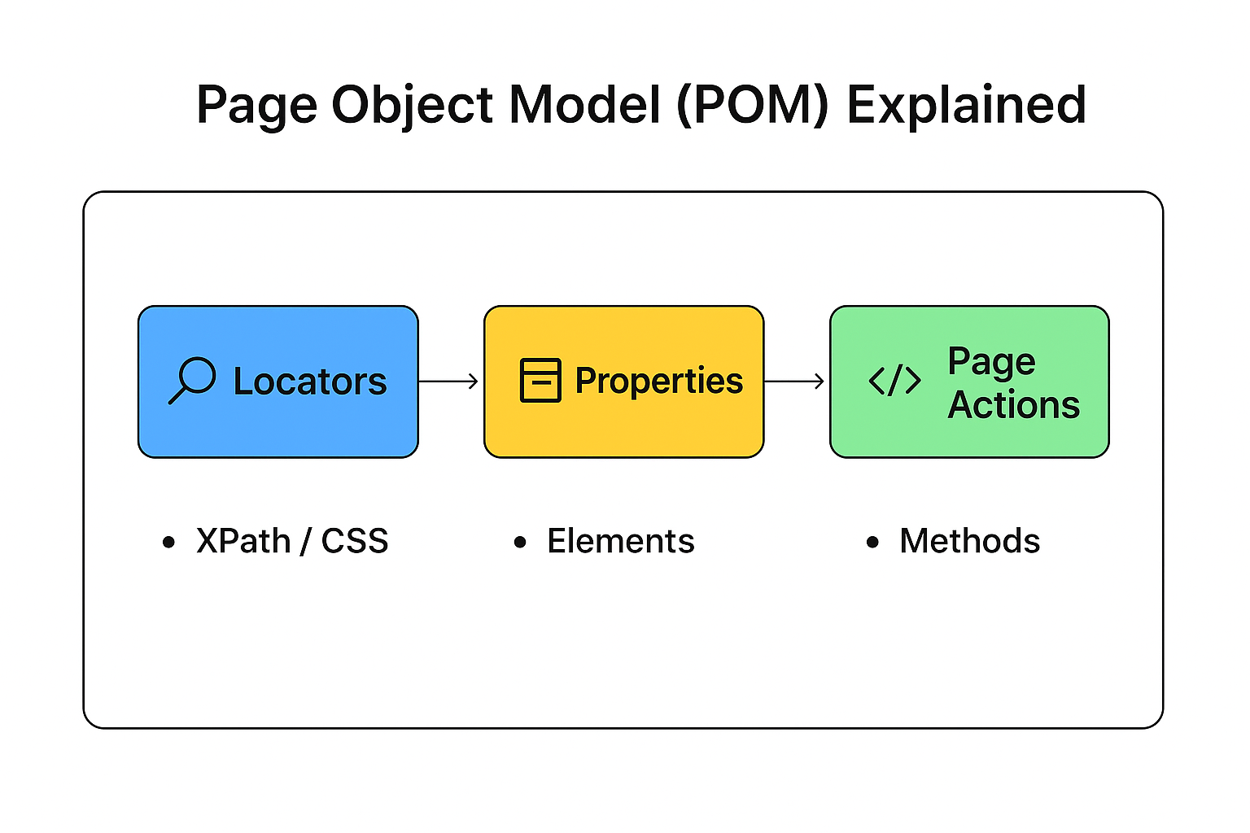
What is POM?
A design pattern used in Selenium automation
Separates locators, elements, and actions
Three Layers in Each Page (POM Structure)
Locators Layer (locators.py)
Contains only XPath / CSS / IDs
Central location for all element selectors
Properties Layer (properties.py)
Converts locators → Selenium Web Elements
Contains @property methods to return elements
Inherits from Locators
Page Actions Layer (page.py)
Contains business logic for that page
Uses properties to access elements
Key Design Principles
Page Object Model (POM): Ensures high modularity by separating UI elements and actions from test scripts.
Feature Isolation: Each module specifically handles one feature, promoting clean separation of concerns.
WebDriver Management: base_test.py centrally manages WebDriver setup and teardown for consistency.
Reporting Integration: conftest.py is used for configuring HTML reports.
Readable Tests: Test scripts remain concise, calling only high-level actions defined in the POM.

Slide 9



Testing and Validation
A multi-faceted approach to ensure comprehensive quality and security.
Functional Tests
Stress Tests
Covered all major user interactions: Login, Logout, Location selection, Search, Filter, Menu, Cart, Checkout, Profile Editing, and invalid credentials scenarios.
Simulated rapid input of over 70 random words into search, validating system performance under heavy load.
Security Tests
Validation
Implemented measures against common vulnerabilities: SQL injection attempts.
Utilized explicit assertions and generated timestamped HTML reports for clear evidence.

Slide 10

Challenges Faced
Locator Instability: UI elements change their attributes
(ID, class names, etc.) due to updates.
Causes: Frontend developers refactoring code, dynamic element IDs.
Browser/Driver Compatibility Issues: Tests might work on one
browser/version but fail on others.
Causes: Differences in browser rendering engines, WebDriver version mismatches with browser versions.
Poor Wait Strategies: Using fixed time.sleep() or inadequate explicit waits.
Causes: Not waiting for specific conditions (element clickable, visible, present), using implicit waits inconsistently.

Slide 11

Overcoming Obstacles: Solutions
Navigating technical complexities to build a robust framework:
1
2
Dynamic UI Elements
Unstable Waits
Resolved by developing stronger, more resilient XPath and CSS selectors, moving beyond basic IDs or class names.
Replaced time.sleep() with explicit waits, improving test reliability and execution speed.
3
Search Suggestions
Implemented custom waits and event listeners to handle the asynchronous loading of search suggestions.
4
5
Maintaining Modularity
Code Duplication
Strict adherence to POM principles and clear interface definitions across numerous Page Object modules.
Introduced a base Page class to abstract common WebDriver actions, reducing redundant code and improving maintainability.

Slide 12

Key Takeaways: Learnings & Improvements
Key Learnings
Improved understanding of POM architecture
Effective use of PyTest fixtures
Enhanced logging and reporting
Use select method to handle drop downs
Areas of Improvement
Reduce sleeps; use WebDriverWait
Improve naming & code organization
Add meaningful assertions
Break long flows into smaller tests

Slide 13

Conclusion:
The Bhoj Deals automation framework is a testament to robust engineering and strategic vision.
Comprehensive Automation
Delivered a complete end-to-end framework covering functional, performance, and security testing.
Significant Efficiency Gains
Drastically reduced manual testing effort, freeing up resources and accelerating release cycles.
Faster, Reliable Releases
Enables rapid deployment of new features with increased confidence in product quality.

